Slide 1



Book Recommendation System

Slide 2


Ahmed Badawy
Anas Elbattra
Esmael Ezz
Members
Yousef shindy

Slide 3

01.
Problem Formulation
02.
03.
Data Preparation
Text Feature Engineering
04.
05.
Clustering
Classification
06.
Table of contents
07.
Evaluation
Error Analysis
08.
Demonstration

Slide 4


Problem Formulation

Slide 5
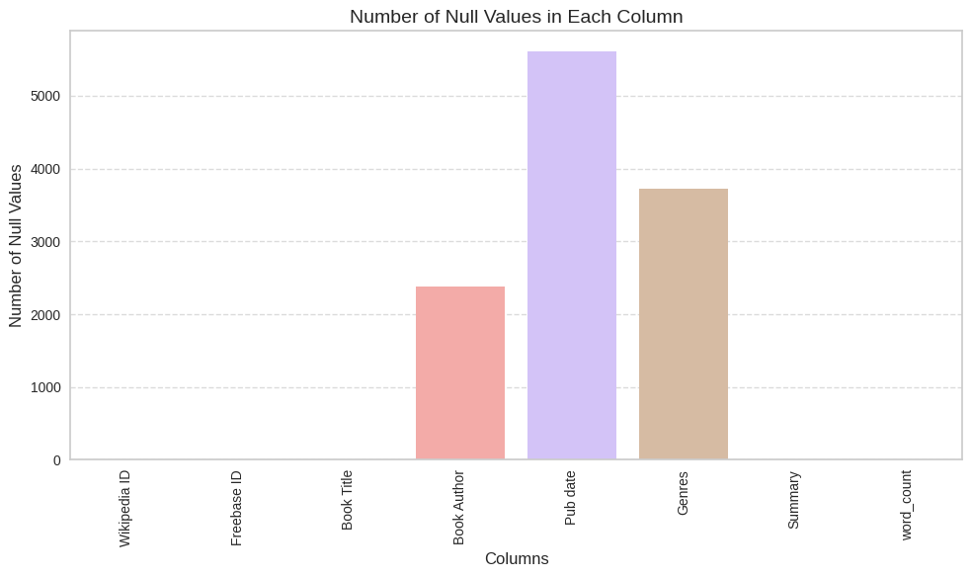
Data Preparation
Handle the missing values
Convert the Genres column from JSON format to a list of genres
Define a word count of the summary column
Took a random sample of 1000 rows from the dataset

Slide 6
Text Feature Engineering
Word Tokenization
Remove Stop Words
Word Lemmatization
Word2Vec

Slide 7
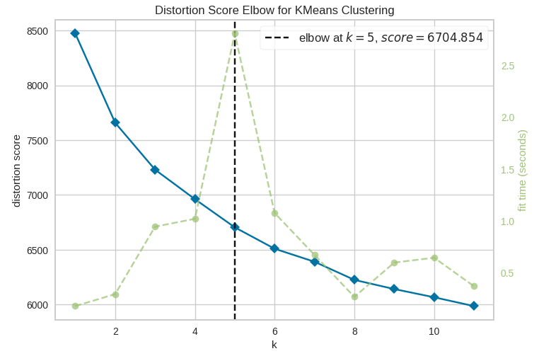
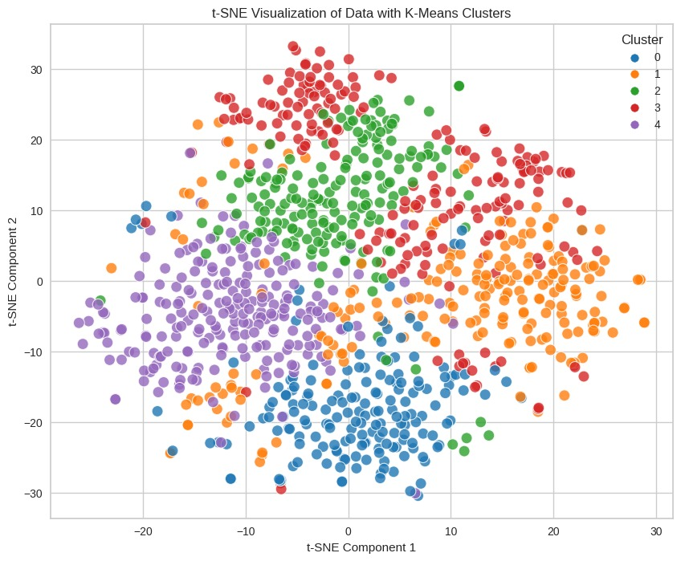
Clustering
Kmeans Algorithm

Slide 8
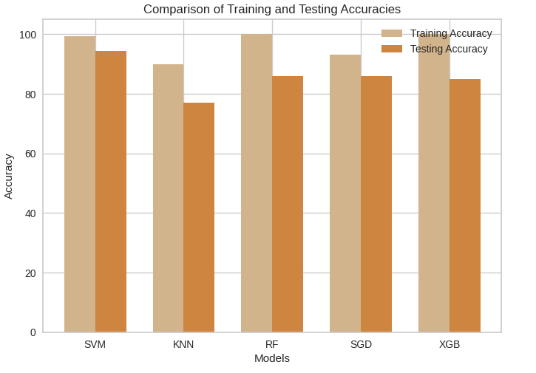
Classification
Model | Test Accuracy
SVM | 0.94
KNN | 0.77
Random Forest | 0.86
SGD | 0.86
XGB | 0.85

Slide 9
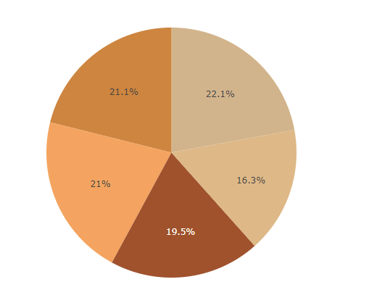
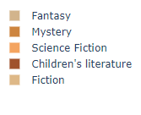
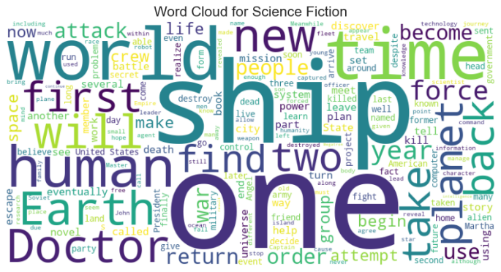
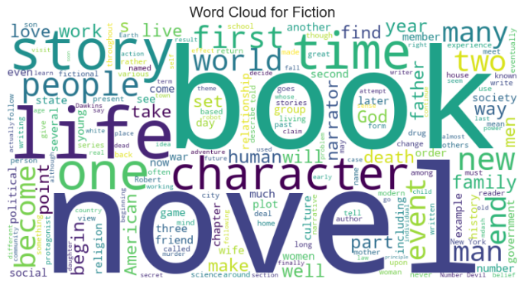
Classification
Check the Genres column for imbalance
Explore The Summaries of Different Genres

Slide 10
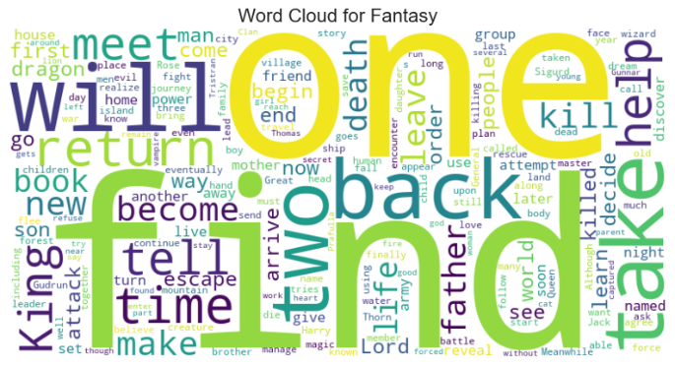
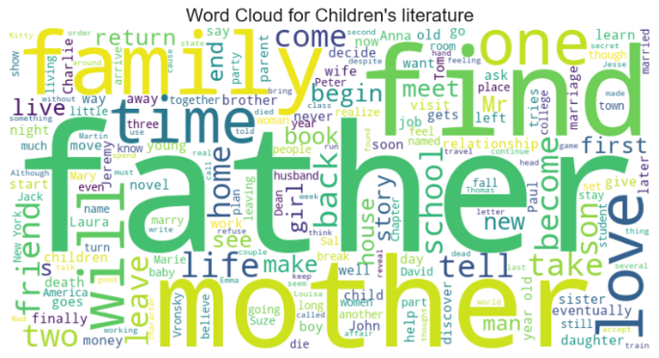
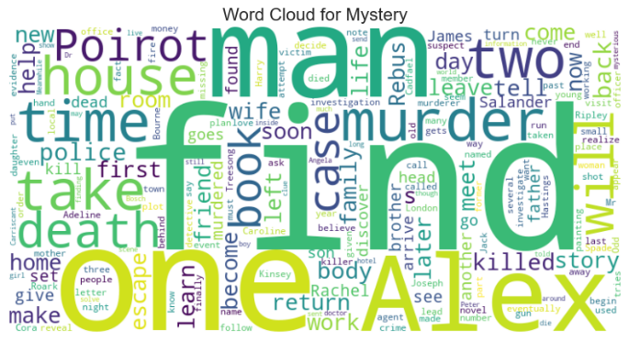
Classification

Slide 11
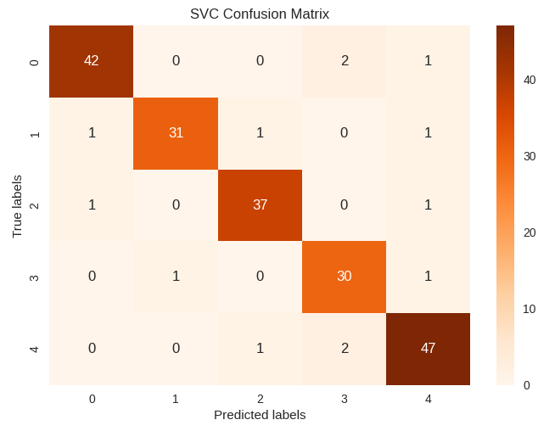
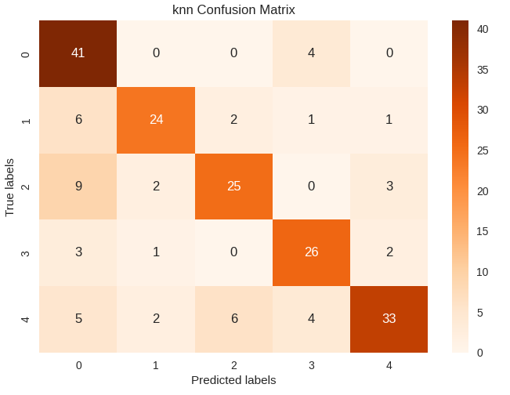
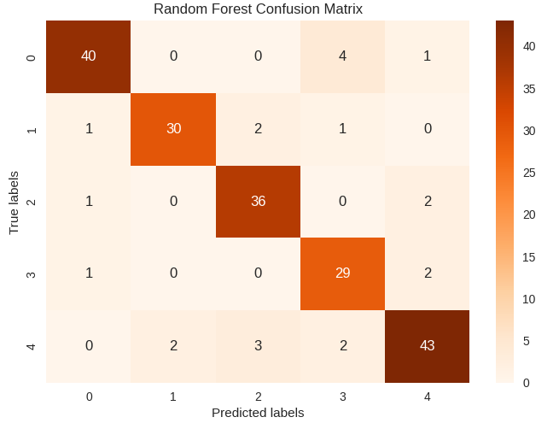
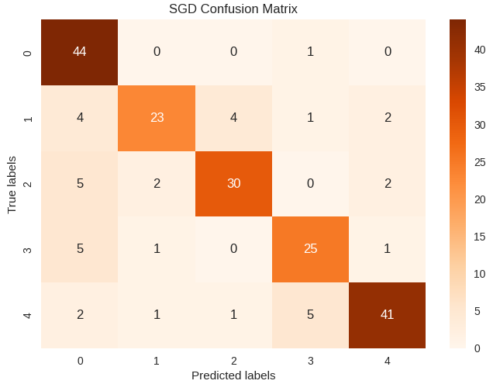
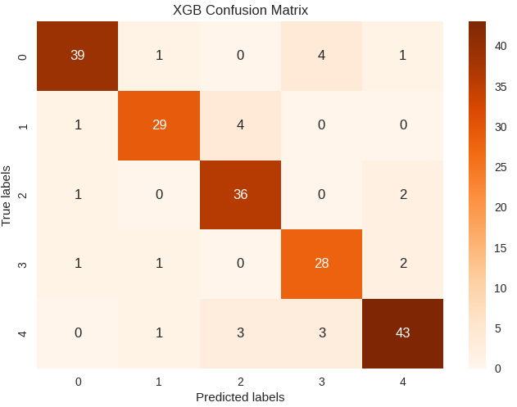
Evaluation & Error Analysis
Confusion Matrix For Classification Models

Slide 12
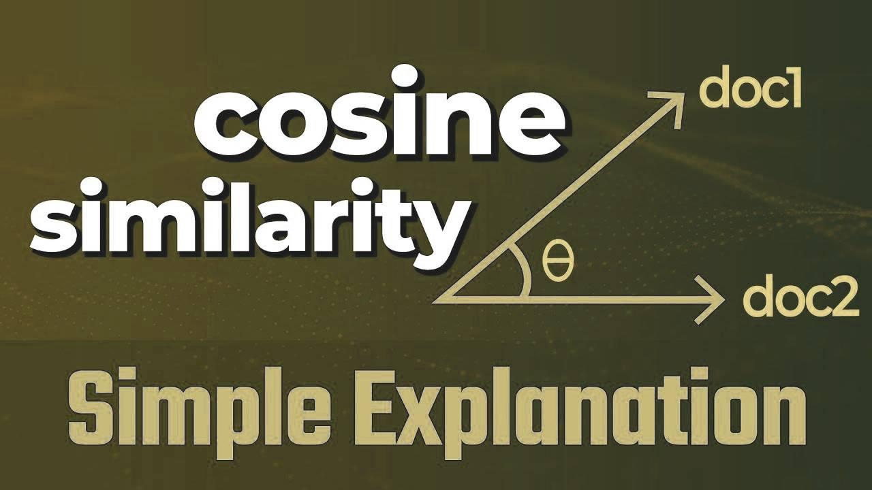
Cosine
Similarity

Slide 13



Chatbot
Tools

Slide 14
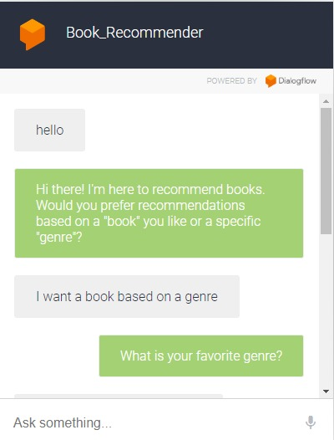
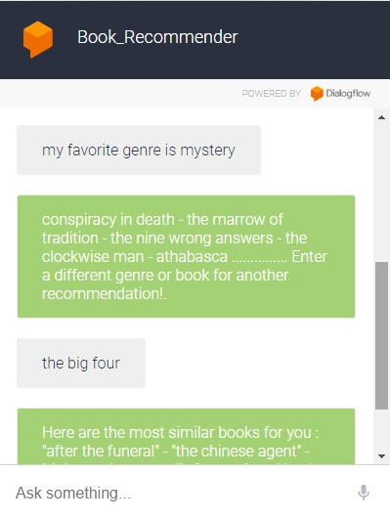
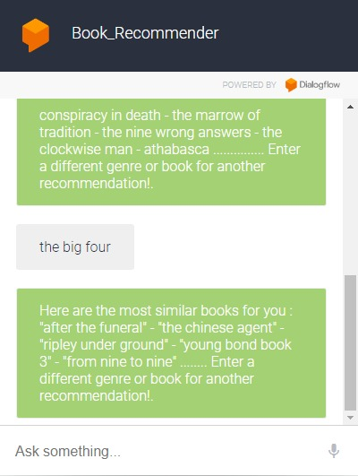
Chat Bot Test Case

Slide 15

Demonstration
https://bot.dialogflow.com/d770968f-d6ad-436d-a024-8a9314ad4272

Slide 16

Thank You

